Slide 1

Data Glacier Final Group Project
Specialization : Data Science
Project Name: Bank Marketing (Campaign)
Group Name : Data Scientist Geeks
Team member 1 Name: Refka Mejri | National Engineering School of Tunis | Tunisia
Team member 2 Name Tasnime Hamdeni | National Engineering School of Tunis | Tunisia

Slide 2

Agenda
Project Roadmap & Executive Summary
Problem Description
Data Intak Report
Data Understanding
Data Cleaning
Exploratory Data Analysis
Model Selection and Model Building

Slide 3
Project Roadmap and Executive Summary

Slide 4
Project Roadmap and Executive Summary
This process is prepared according to the needs of the company and the submission of each week.
The Data Glacier company give us as a data scientist team this mission.
We will develop a ML Model to shortlist customer whose chances of buying the product is more so that their marketing channel can focus only on those customers whose chances of buying the product is more.
Week7
Business understanding and problem description
Week8
Data Analysis and descriptive data study
Week9
Data Preprocessing
Week10
Week11
Week12
Presentation
Preparing the presentation
Preparing the report
Exploratory Data Analysis
Preparing Report
Preparing presenation for EDA and Data Preprocessing
Bulding the machine Learning model for prediction
Week13
Prepare presentation with final results and recommandation for clients.

Slide 5
Problem description

Slide 6
Problem description
We want to get some insight from the data of a bank called ABC that wants to sell it's term deposit product to customers and before launching the product they want to develop a model which help them in understanding whether a particular customer will buy their product or not (based on customer's past interaction with bank or other Financial Institution).
Using Machine Learning models, our goal is to help companies shortlist customers whose chances of buying products is more so that their marketing channel can focus on them.

Slide 7
Data Intak Report

Slide 8
Data Intake Report
Name: Bank Marketing (Campaign)
Report date: 19/12/2021
Internship Batch : LISUM04
Version:
Data intake by: Refka Mejri and Tasnime Hamdeni
Data intake reviewer:
Data storage location: https://archive.ics.uci.edu/ml/datasets/Bank+Marketing
Tabular data details:
bank-additional-full
bank-additional
Total number of observations | 41188
Total number of files | 1
Total number of features | 21
Base format of the file | csv
Size of the data | 4,70 Mo
Total number of observations | 4119
Total number of files | 1
Total number of features | 21
Base format of the file | csv
Size of the data | 570 Ko
Bank-full
Bank
Total number of observations | 45211
Total number of files | 1
Total number of features | 17
Base format of the file | csv
Size of the data | 4,83 Mo
Total number of observations | 4521
Total number of files | 1
Total number of features | 17
Base format of the file | csv
Size of the data | 450 Ko

Slide 9
Data Understanding

Slide 10
We have information about $41188$clients in a csv file of size $4.70 Mo$. For each client, $21$ attributes are available in the data. Some demographic data such as:
Data understanding
1 - age (numeric) 2 - job : type of job (categorical: 'admin.','blue-collar','entrepreneur’, 'housemaid’, 'management',’ retired’, 'self-employed’, 'services’, 'student’, 'technician','unemployed','unknown') 3 - marital : marital status (categorical: 'divorced','married','single','unknown'; note: 'divorced' means divorced or widowed) 4 - education (categorical: 'basic.4y', 'basic.6y', 'basic.9y', 'high.school', 'illiterate', 'professional.course’, 'university.degree', 'unknown') 5 - default: has credit in default? (categorical: 'no','yes','unknown') 6 - housing: has housing loan? (categorical: 'no','yes','unknown') 7 - loan: has personal loan? (categorical: 'no','yes','unknown’)

Slide 11
Some data related with the last contact of the current campaign like:
Data understanding
8 - contact: contact communication type (categorical: 'cellular','telephone') 9 - month: last contact month of year (categorical: 'jan', 'feb', 'mar', ..., 'nov', 'dec') 10 - day_of_week: last contact day of the week (categorical: 'mon','tue','wed','thu','fri') 11 - duration: last contact duration, in seconds (numeric). Important note: this attribute highly affects the output target (e.g., if duration=0 then y='no'). Yet, the duration is not known before a call is performed. Also, after the end of the call y is obviously known. Thus, this input should only be included for benchmark purposes and should be discarded if the intention is to have a realistic predictive model.

Slide 12
Some other attributes are as well fully available like:
Data understanding
12 - campaign: number of contacts performed during this campaign and for this client (numeric, includes last contact) 13 - pdays: number of days that passed by after the client was last contacted from a previous campaign (numeric; 999 means client was not previously contacted) 14 - previous: number of contacts performed before this campaign and for this client (numeric) 15 - poutcome: outcome of the previous marketing campaign (categorical: 'failure','nonexistent','success’)

Slide 13
Some social and economic context attributes like:
Data understanding
16 - emp.var.rate: employment variation rate - quarterly indicator (numeric) 17 - cons.price.idx: consumer price index - monthly indicator (numeric) 18 - cons.conf.idx: consumer confidence index - monthly indicator (numeric) 19 - euribor3m: euribor 3 month rate - daily indicator (numeric) 20 - nr.employed: number of employees - quarterly indicator (numeric)
The output variable or so called the desired target is given by the varibale:
21 - y - has the client subscribed a term deposit? (binary: 'yes','no')

Slide 14
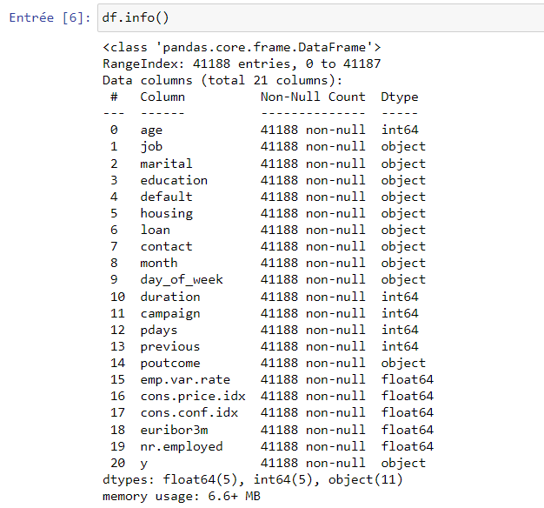
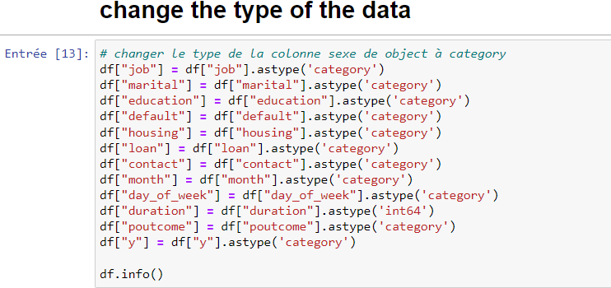
Types of data
Data of type object should be converted into category data. The type of data after conversion is:

Slide 15
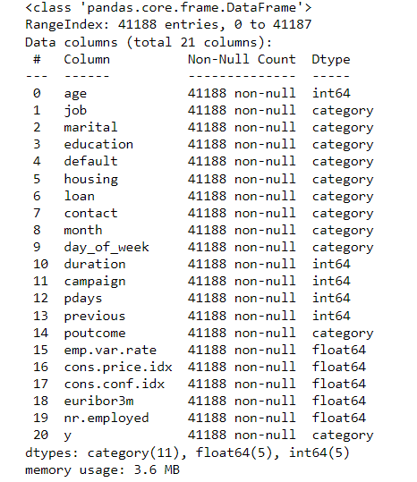
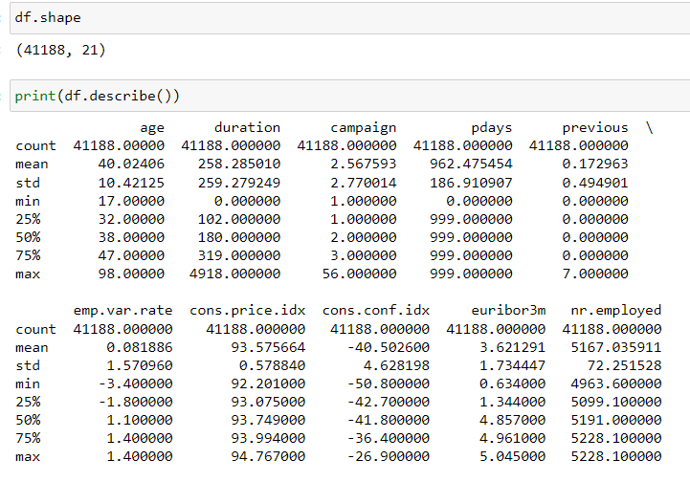
Types of data
Data after conversion are given by:
Descriptive statistics were calculated to extract initial and preliminary insights

Slide 16
Data cleaning

Slide 17
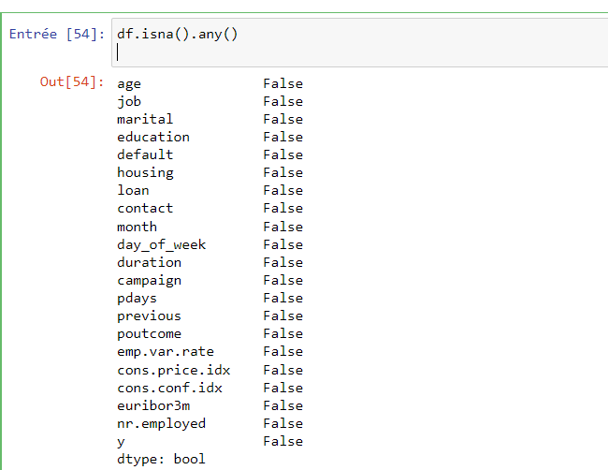
Problems in the data: NA Values
There are no NA values in the data

Slide 18
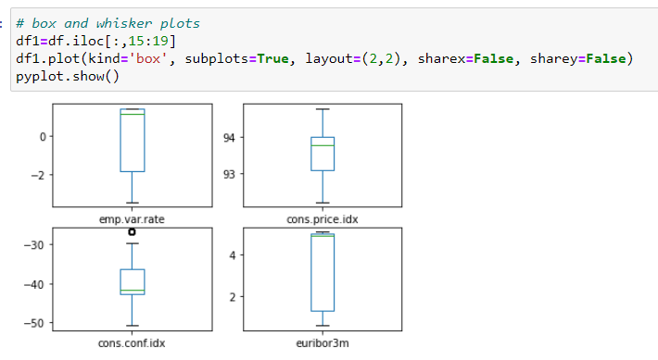
Problems in the data: Outliers
We calculate the z-score to detect outliers and we can also draw the box plot to check the eventual existence of outliers:

Slide 19
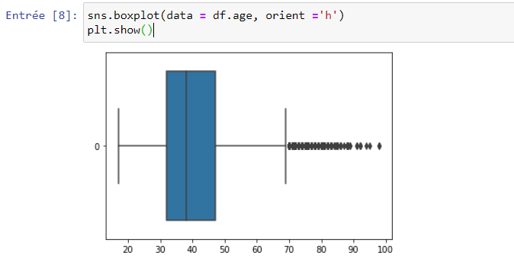
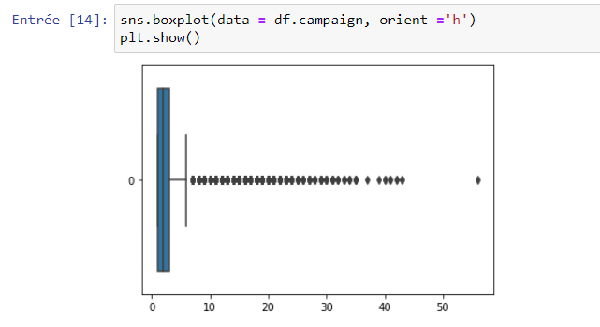
Problems in the data: Outliers

Slide 20
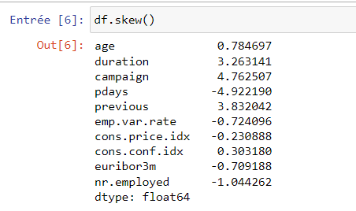
Problems in the data: Skewness

Slide 21
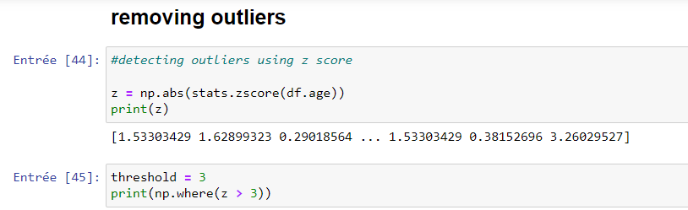
Problem overcoming techniques: Removing
outliers
We can deal with outliers either by calculating the z-score or by calculating the interquartile range.
Using Z-score
The z-score is a numerical value that quatifies the relationship to the mean of of the values in our data. Z-score is measured in terms of standard deviations from the mean.

Slide 22
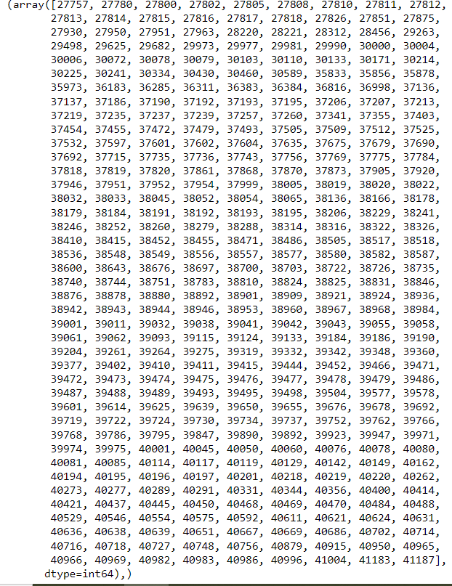
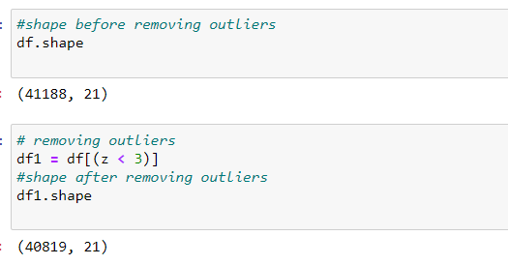
Problem overcoming techniques: Removing
outliers
Before removing outliers, we had 41188 observations or clients’ data.
After removing outliers, we ended up with 40819 observations
We had 369 outliers

Slide 23
Data cleaning
Missing values : After verifiying missing values I conclude that we don’t have missing values in our dataset.
Duplication rows : The dataset contain 12 rows duplicated, I droped them using drop function
Outliers: We found 369 outliers and removed them
Skewness: Some feature were skewed to the right and some other feature were skewed to the left

Slide 24
Other transformations done on the data
We checked that there are no intruders in the categorical data
We checked that there are no durations that are equal to zero
There are no NA values to be cleaned in the data
We detected duplicated data and deleted them
We drew some visualizations for the data understanding

Slide 25
Exploratory Data Analysis

Slide 26
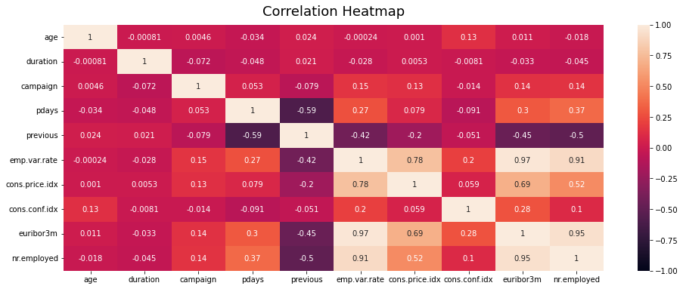
Features correlations
The emp.var.rate, euriborn3m, nr.employed and cons.price.index are the 3 highly correlated attributes.

Slide 27
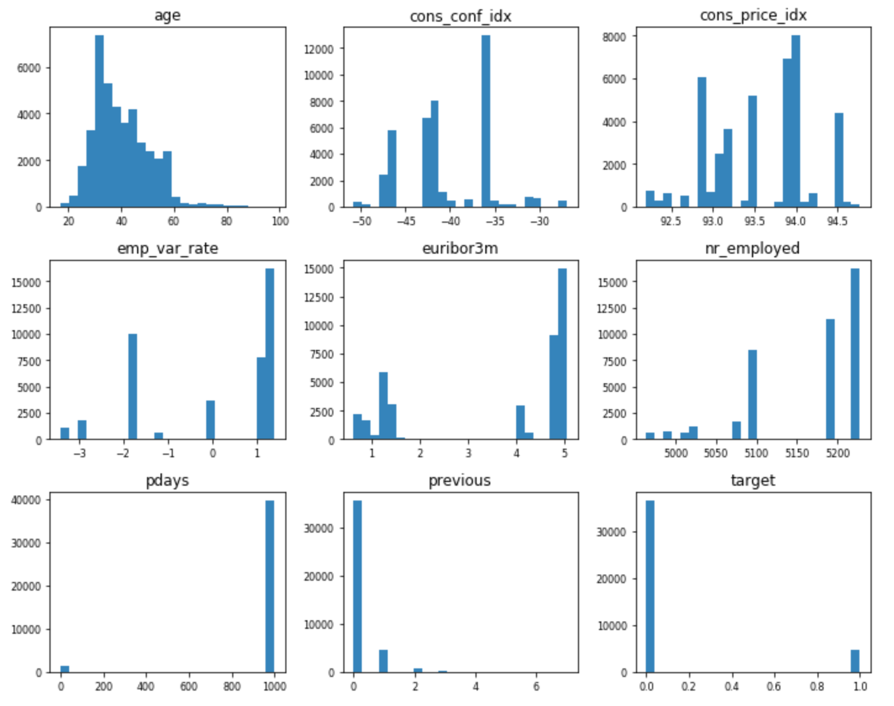
Statistic description and numerical attributes

Slide 28
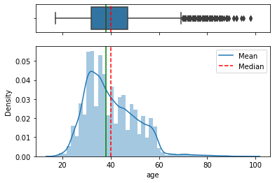
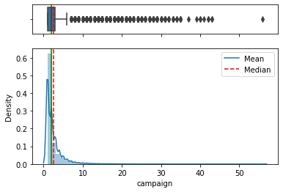
Outlier Detection
From boxplot and histogram of numerical variables plotted using univariate analysis, we can see that our data have outlier on age and campain attributes.
We can observe that we have dispersion in our data, specially in the age and campaign attributes.We handle them using percentile and z-score method but, actually we will not drop them.In fact we can see that they have a normal behavior as we work with a real-world dataset.

Slide 29
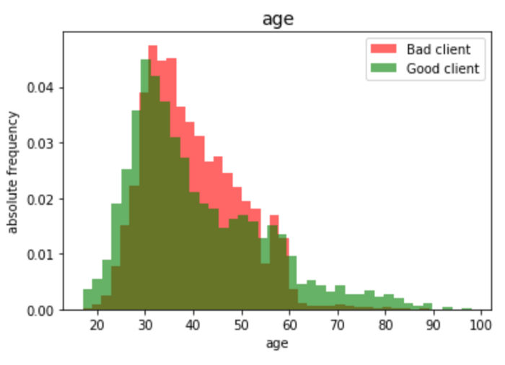
Distribution of customers’age per target
There are more subscribers aged between less than 30 and more than 60 years old than between those from 30 to 60 years old.

Slide 30
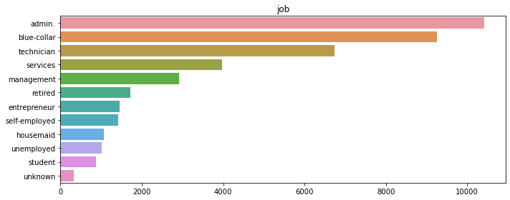
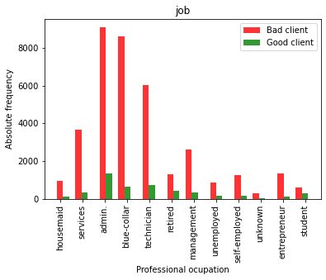
Insights related to the client’s jobs
From the second graph, we can conclude that people with admin, blue_collar and technician jobs are more contacted by the bank.It can be explained by their social situation and the bank expectation.
From the first plot, we see student and retired are the more subscribed according to the total numbers of people by job category.

Slide 31
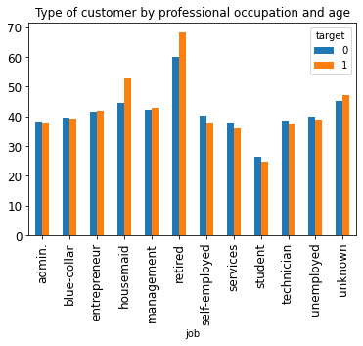
Insights related to the jobs and ages
of the population
We can observe that retired and housemaid are the oldest customers and the more classe that accepted to subscribe to the term deposit.

Slide 32
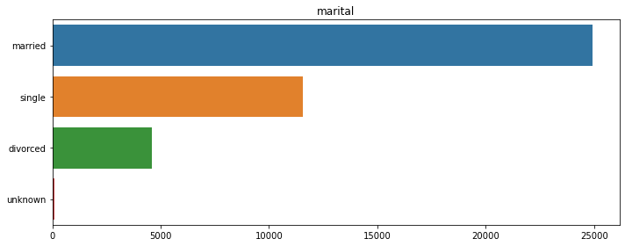
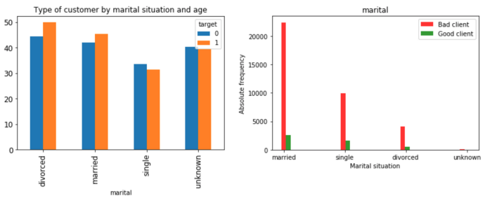
Customer repartition per marital situation
and age analysis
The married class are the dominated class contacted and subscribed to the term deposit

Slide 33
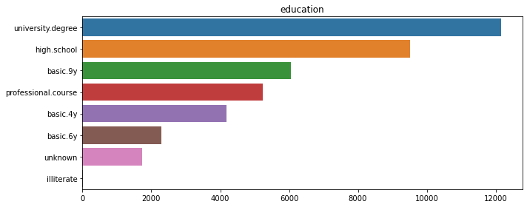
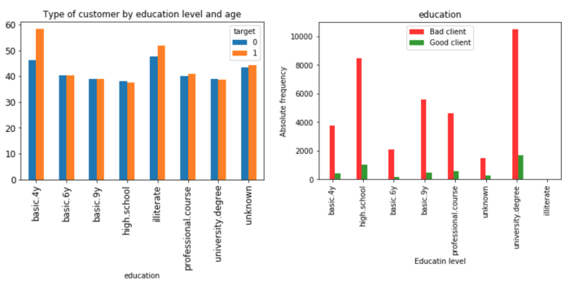
Customer repartition per education
and age analysis
The more educated class are the dominated class in term of bank contact and also for deposit subscription.

Slide 34
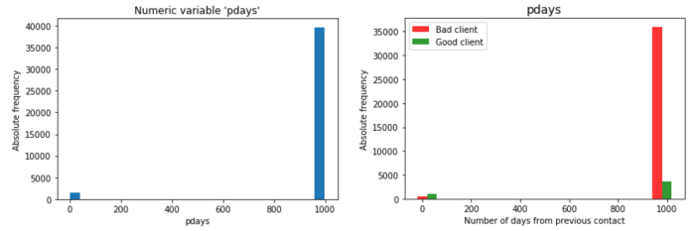
Distribution of Day and also the variable
against the target.

Slide 35
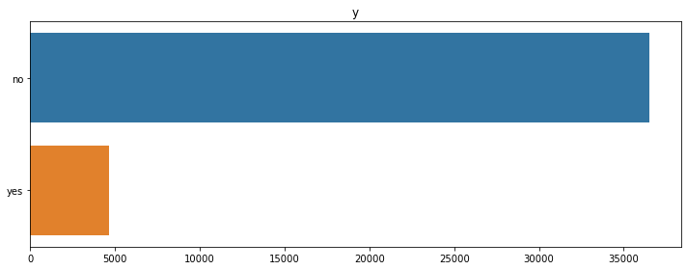
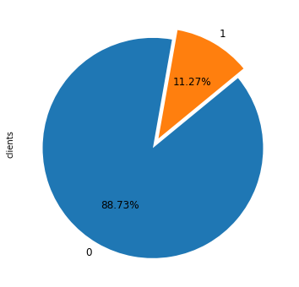
Target repartition and data balencement
The dataset is imbalanced with the class no is higher than the class yes

Slide 36
EDA summary
In this section we worked on three important steps:
Data Cleaning: where we clean data, verify duplication, missing values and outliers
Data description analysis : We extract information from analyzing visualisation for numerical and categorical attributes.We used univariates and bivariates analysis to extract insight from some attributes.
It’s recommanded to take more time to work and analyze all attributes in order to inderstand well our data and to be able to give more pertinent advice to our client

Slide 37
Model Selection and Model Building

Slide 38
Implementing one-hot encoding through category_encoder
Data need to be prepared in a specific ways before fitting a machine learning model.
One good example is to use a one-hot encoding on categorical data.
Why is a one-hot encoding required?
Why can’t you fit a model on your data directly?
Categorical data are variables that contain label values rather than numeric values. The number of possible values is often limited to a fixed set.
Categorical variables are often called nominal

Slide 39
Implementing one-hot encoding through category_encoder
Many machine learning algorithms cannot operate on label data directly. They require all input variables and output variables to be numeric.
In general, this is mostly a constraint of the efficient implementation of machine learning algorithms rather than hard limitations on the algorithms themselves. For categorical variables where no such ordinal relationship exists, the integer encoding is not enough.
In fact, using this encoding and allowing the model to assume a natural ordering between categories may result in poor performance or unexpected results (predictions halfway between categories).
In this case, a one-hot encoding can be applied to the integer representation. This is where the integer encoded variable is removed and a new binary variable is added for each unique integer value.

Slide 40
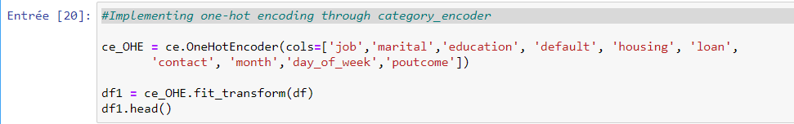
Implementing one-hot encoding through category_encoder
In fact, using this encoding and allowing the model to assume a natural ordering between categories may result in poor performance or unexpected results (predictions halfway between categories).
In this case, a one-hot encoding can be applied to the integer representation. This is where the integer encoded variable is removed and a new binary variable is added for each unique integer value.

Slide 41
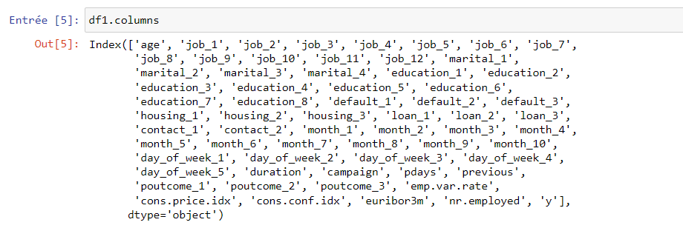
Implementing one-hot encoding through category_encoder
Instead of 21, we have now 63 columns assuming that each type for each feature represents a type for itself.
This is the first direct effect done thanks to using one-hot encoding.

Slide 42
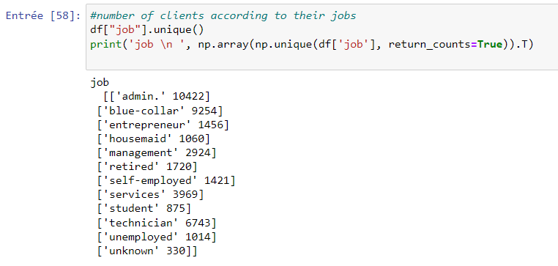
Implementing one-hot encoding through category_encoder
We see that the new 21 columns created after effectuating the one-hot encoding correspond to the 21 job types available in the data as shown in the results above .

Slide 43
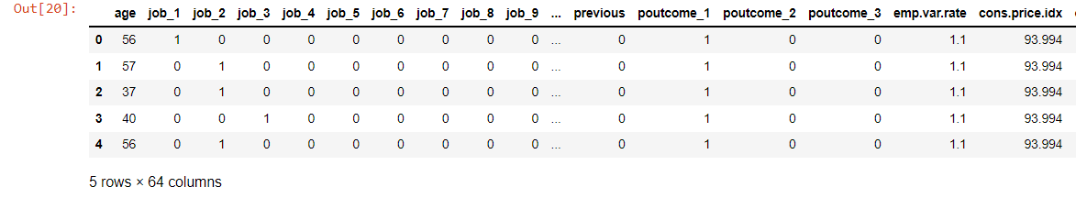
Implementing one-hot encoding through category_encoder (Output)
In the “job” variable, there are 12 categories and therefore 12 binary variables are needed. A “1” value is placed in the binary variable for the job type and “0” values for the other job types.

Slide 44
Steps after data encoding
Now it is time to create some models of the data and estimate their accuracy on the bank marketing campaign data.
Here is what we are going to cover in this step:
Separate out a validation dataset.
Set-up the test harness to use 10-fold cross validation.
Build multiple different models to predict species from flower measurements
Select the best model.

Slide 45
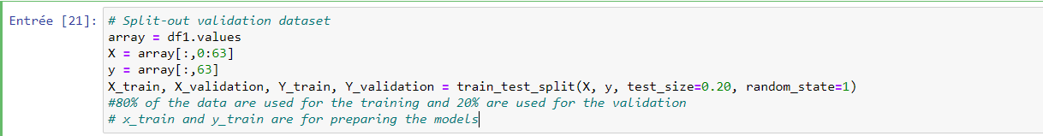
Split-out validation dataset
80% of the data are used for the training and 20% are used for the validation
x_train and y_train are for preparing the models

Slide 46
Machine learning models to be
implemented
We don’t know which algorithms would be good on this problem or what configurations to use. We get an idea from the plots that some of the classes are partially linearly separable in some dimensions, so we are expecting generally good results. Let’s test 6 different algorithms:
Logistic Regression (LR)
Linear Discriminant Analysis (LDA)
K-Nearest Neighbors (KNN).
Classification and Regression Trees (CART).
Gaussian Naive Bayes (NB).
Support Vector Machines (SVM).

Slide 47
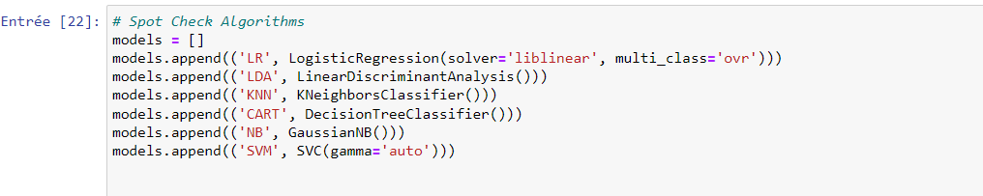
Machine learning model building
→ This is a good mixture of simple linear (LR and LDA), nonlinear (KNN, CART, NB and SVM) algorithms.

Slide 48
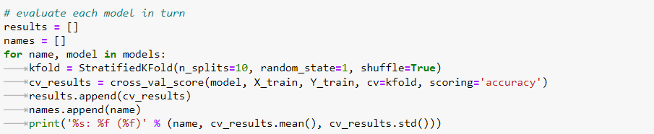
Model evaluation
We use stratified 10-fold cross validation to estimate model accuracy. We are using the metric of ‘accuracy‘ to evaluate models. This is a ratio be multiplied by 100 to give a percentage.

Slide 49
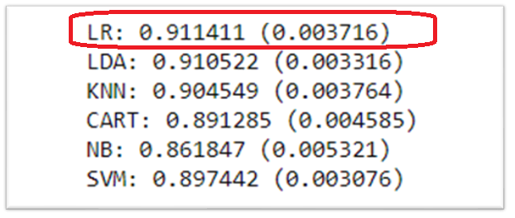
Obtained results
Linear Regression has the largest estimated accuracy score at about 0.91 or 91%.
We can also create a plot of the model evaluation results and compare the dispersion and the mean accuracy.

Slide 50
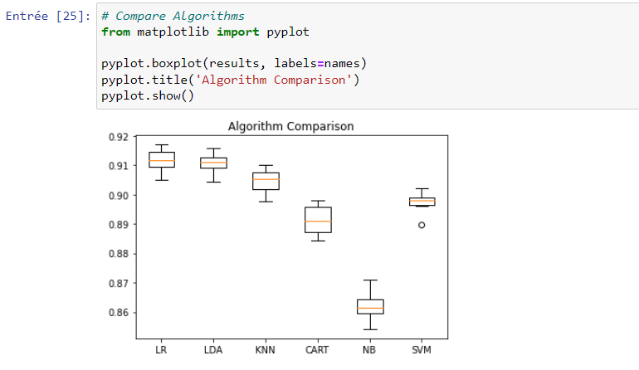
Box and whisker for algorithm comparison

Slide 51
Obtained results
We must choose an algorithm to use to make predictions.
The results in the previous section suggest that the Linear Regression was perhaps the most accurate model. We will use this model as our final model.
Now we want to get an idea of the accuracy of the model on our validation set. This will give us an independent final check on the accuracy of the best model. It is valuable to keep a validation set just in case you made a slip during training, such as overfitting to the training set or a data leak. Both of these issues will result in an overly optimistic result.

Slide 52
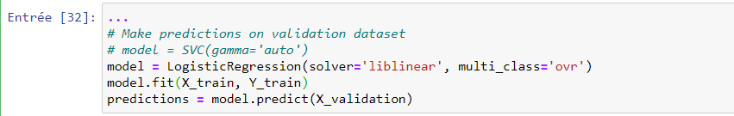
We can fit the model on the entire training dataset and make predictions on the validation dataset.
Make predictions on validation dataset

Slide 53

We can evaluate the predictions by comparing them to the expected results in the validation set, then calculate classification accuracy, as well as a confusion matrix and a classification report.
Evaluation predictions

Slide 54
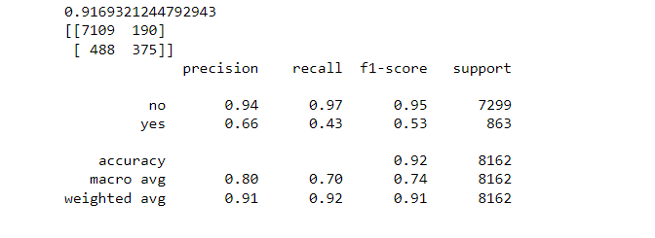
Evaluation predictions
We can see that the accuracy is 0.92 or about 92% on the hold out dataset.
The confusion matrix provides an indication of the errors made.
Finally, the classification report provides a breakdown of each class by precision, recall, f1-score and support showing excellent results,

Slide 55
Recommendation
The obtained results aren’t bad, but they can be better.
One way to make them is to, for example, modify the model parameters and test the accuracy. We can also reduce unbalanced data to improve the model precision and accuracy,
A bigger dataset would improve the results as well.
Univariate, bivariate and multivariate analysis can also be performed in the Exploratory Data Analysis step that will definitely help obtain more insights from the data,

Slide 56
Thank You

